Slide 1

Data Model Approach
Tenacious​

Slide 2

A1 Chips
Tenacious ​
E
A
R
Entity
Attributes
Relationship
Requirements
Register
Login
View products
Cart
Order
Payment

Slide 3
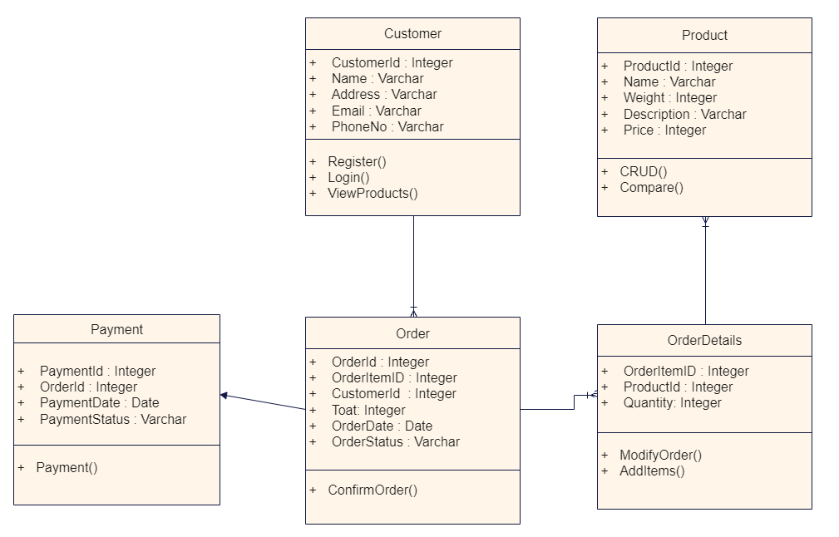
Data Model
Tenacious ​

Slide 4
DataBase Design
Tenacious ​
User
User_ID | int | primary key
Name | varchar(50)
Email | varchar(50)
Phone | varchar(10)
Address | varchar(max)
Product
Product_ID | int | primary key
Product_Name | varchar(50)
Weight | varchar(10)
Description | varchar(max)
Price | decimal(5,2)
Order
Order_ID | int | Primary Key
User_ID | int | Foreign Key
Order_Status | varchar(50)
Total | decimal(5,2)
Orderdetails_ID | int | Foreign Key
Order Details
Orderdetails_ID | int | primary key
Product_ID | int | Foreign Key
Quantity | int
Payment
Payment_ID | int | Not Null
Payment_Status | varchar(50)
Order_ID | int | Foreign Key

Slide 5
DataBase Table
Tenacious ​
Customer
Cust id | Name | Address | E-mail | Phone
1 | Ajay | Chennai | ajay@gmail.com | 8934567890
2 | Jeeva | Theni | jeeva@gmail.com | 9807654321
Product
Product id | Product Name | Description | Weight | Price
1001 | Banana Chips | Spicy And Sweet | 100 gm | 30
1002 | Potato Chips | Spicy | 150gm | 60
Order Details
Order Item id ​​​​ | Product Id ​​​​ | Quantity ​​​​
3011 ​​​​ | 1001 ​​​​ | 2 ​​​​
3011​ | 1002 ​​​​ | 1 ​​​​
3012 ​​​​ | 1002 ​​​​ | 2 ​​​​
3013​​​​ | 1001 ​​​​ | 1 ​​​​

Slide 6
DataBase Table
Tenacious ​
Order
Order Id ​​​ | Order Item id​ | Cust id ​​​ | Total ​​​ | Order Date ​​​ | Order Status ​​​
201 ​​​ | 3011​ | 1 ​​​ | 120 ​​​ | 29-03-2022 ​​​ | Delivered ​​​
202 ​​​ | 3012​ | 2 ​​​ | 120 ​​​ | 30-03-2022 ​​​ | Dispatched ​​​
203 ​​​ | 3013​ | 1 ​​​ | 30 ​​​ | 31-03-2022 ​​​ | Dispatched ​​​
Payment
Payment Id | Order Id | Payment Date | Payment Status
401 | 201 | 29-03-2022 | Success
402 | 202 | 30-03-2022 | Success
403 | 203 | 31-03-2022 | Success

Slide 7


